Slide 1
FOODY HEALTHY
MARKETPLACE
Made By :
Rihab El Arbi
Nour Ben Rhouma
IOT2A

Slide 2
Problem :
The healthy trend, which means "healthy eating", is gaining more and more ground in the world over the years. More than a simple phenomenon, eating healthy has become for some people a real way of life. On the marketplace side, this trend is also attracting many establishments which now offer a “healthy” menu, made up of local and organic products.

Slide 3
Solution :
our solution is to create a marketplace that offers the opportunity to eat a healthy food in addition There is nothing like ordering a home delivery service, eating in the comfort of your own home is sometimes relaxing and even more if you don't have to cook yourself.
our specialty is to prepare healthy meals, our dishes taste good and are offered at advantageous prices for our customers, and we have a home delivery service. Our menu of ready meals is so varied that you can eat to your liking, hassle-free and economically.
we realize that each person has their own nutritional needs, which is why we take care to provide you with complete and delicious options. Order your meals with us and enjoy our healthy food recipes and our 100% homemade gourmet flavors.
you have the opportunity to be a vendor and buy your meals.

Slide 4
Technologies Used :
we used in our front-end development of our marketplace different technologies such as HTML, CSS and JavaScript and for UX/UI Design we used Figma.

Slide 5
Agile Methodology :
we used the agile scrum methodology as a working method in our development, which is a project management method. The idea, when using this approach, is to bring flexibility and performance to project management. Centered on people and communication, it allows customers to participate in the development of a product throughout the progress of the project.

Slide 6
Product backlog : to be able to :
log in
Sign up
be a salesman
choose a category according to his needs
choose the product to buy
pay
choose the language
contact the marketplace managers in case of questions
consult the Frequently Asked Questions page
guide the marketplace visitor through the Free Assessment page
ability for the seller to place his product on the marketplace

Slide 7
for the marketplace managers(admin) to accept the visitor to be a seller,
for the marketplace manager(admin) to accept the visitor to be able to publish his product for sale on the marketplace
have loyalty and cashback program :
the visitor get 500 Points when he Sign up to his Account
the visitor get 1 $ = 1 Point when he Complete purchases through the marketplace
the visitor earn 300 Points when he Refer a friend to the marketplace
the visitor get 5 Points when he Rate our food quality and experience per daily rate
the visitor Get 200 bonus points for his birthday
Update profile
Accept bank card
Rate and review
Implement forget password function

Slide 8
Sprint backlog:
Create a graphic chart
Create the home page
Create the page for each category
Create the seller's page
Realize the page « FAQ »
Realize the page « log in »
Realize the page « sign up »
Realize the page « contact Us »
Realize the page « loyalty & cashback Program »
Realize the page « Free Assessment »

Slide 9
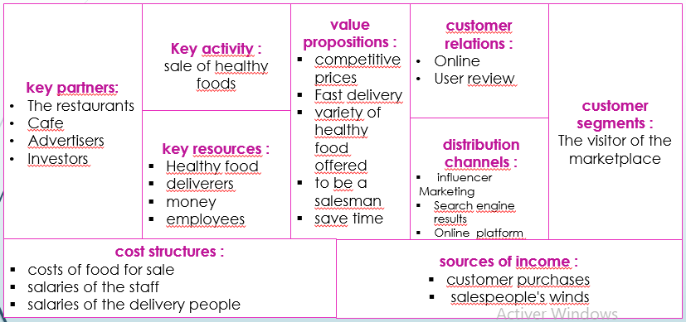
Business Model Canvas :

Slide 10
UML Design :
Use Case Diagram

Slide 11
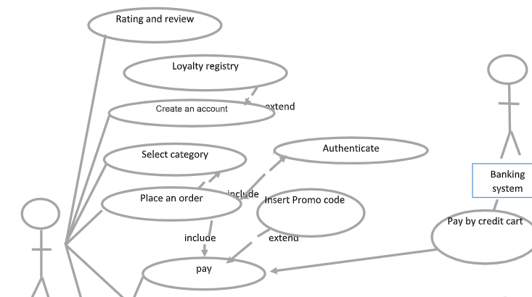
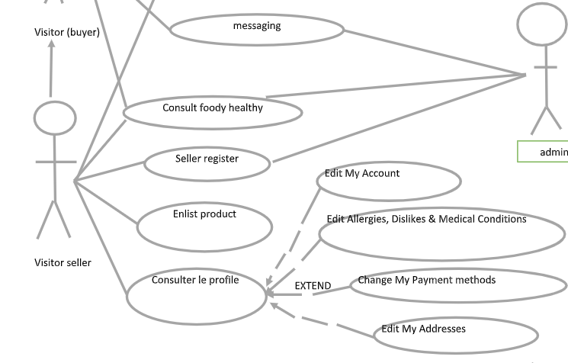

Slide 12
Sequence Diagram :

Slide 13
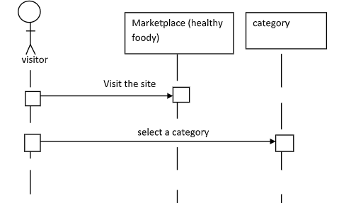

Slide 14
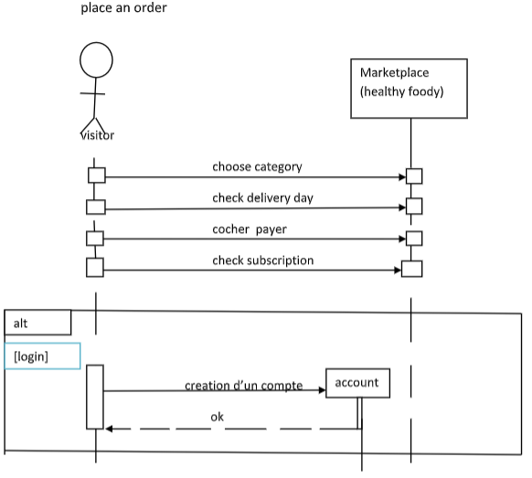
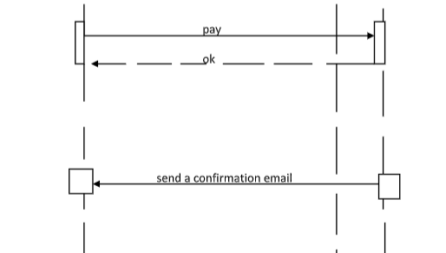

Slide 15
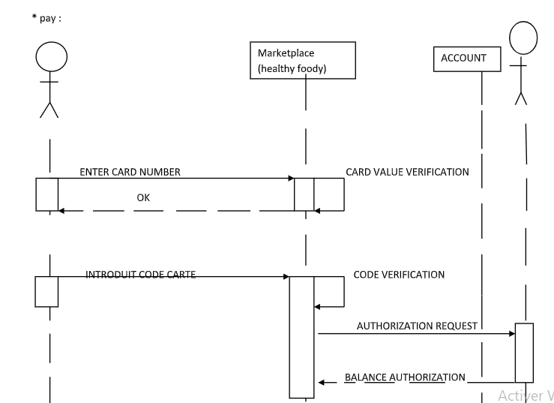
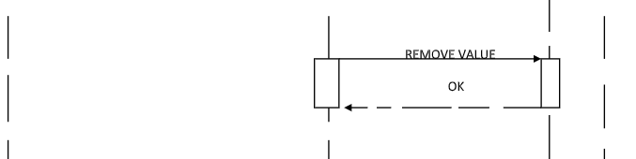

Slide 16
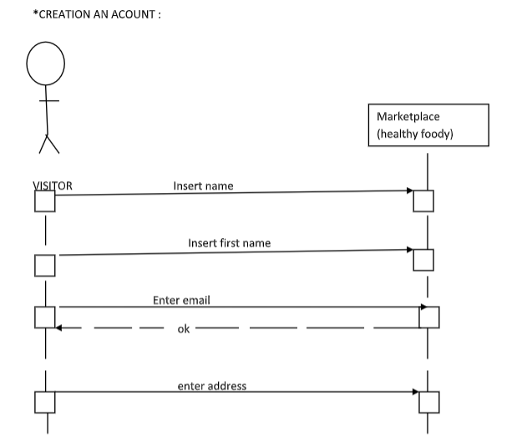
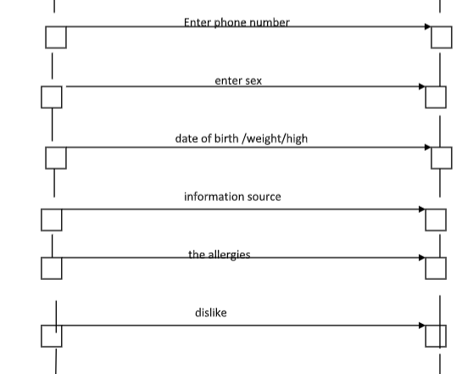
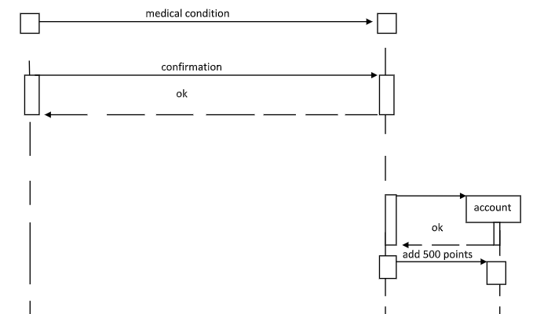

Slide 17
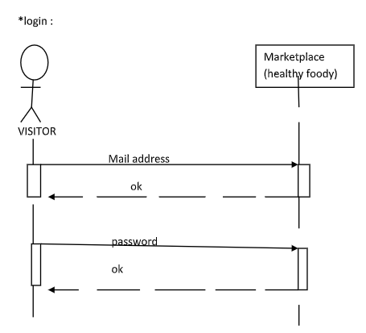

Slide 18
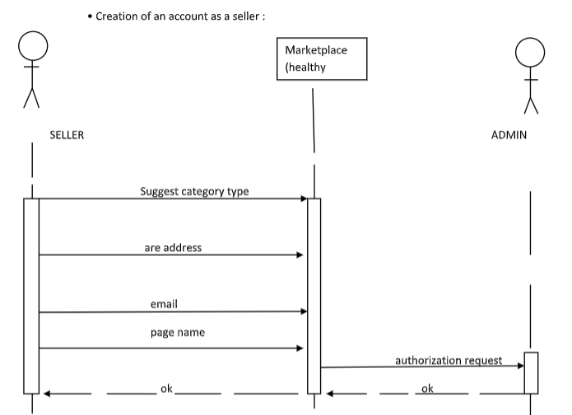
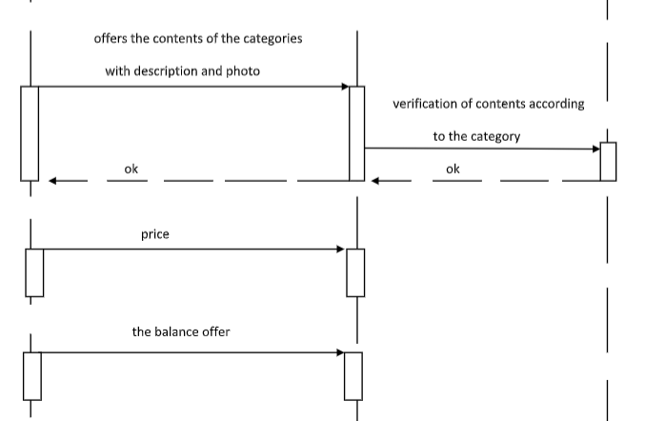

Slide 19
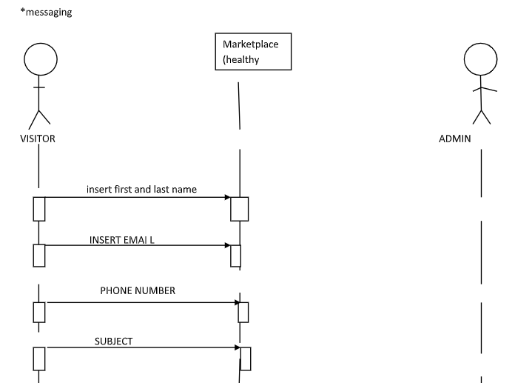
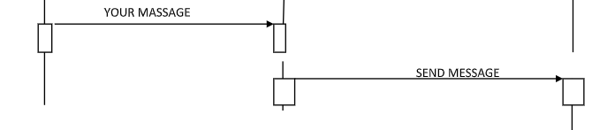

Slide 20
UX/UI Design: FIGMA :

Slide 21
You can visit the links below about Figma :
https://www.figma.com/file/T6XjaQVbOrGG5vAvN2jJbv/Untitled?node-id=12-3&t=sisrymYMUDo4l5wQ-0
And also the second link:
https://www.figma.com/file/z2jJ3WpSVwK4kDMlgOyTlS/marketplace-foody-healthy?node-id=10-2&t=plcYR9RDTONpGoae-0
Or simply the figma’s screenshoots below

Slide 22
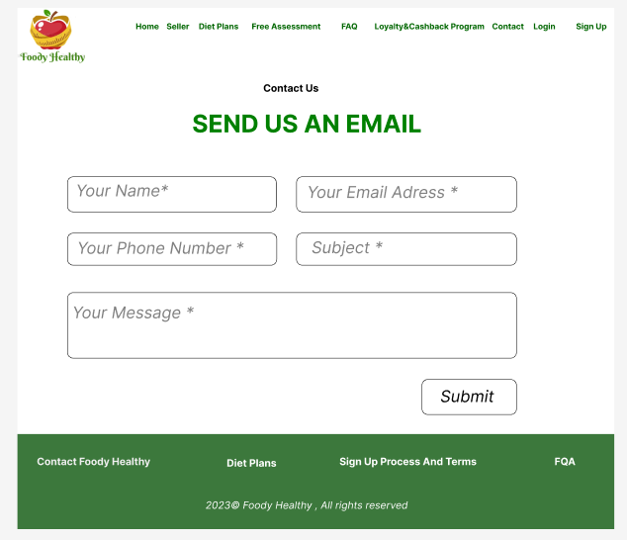

Slide 23
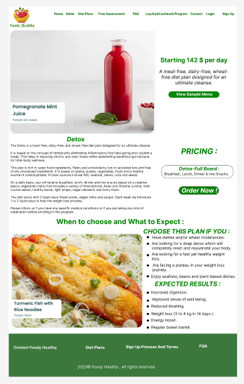

Slide 24
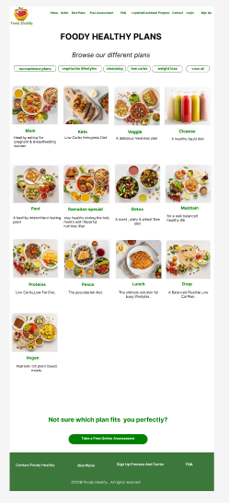

Slide 25
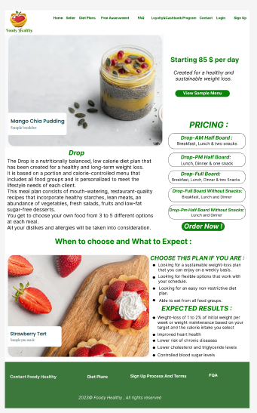

Slide 26
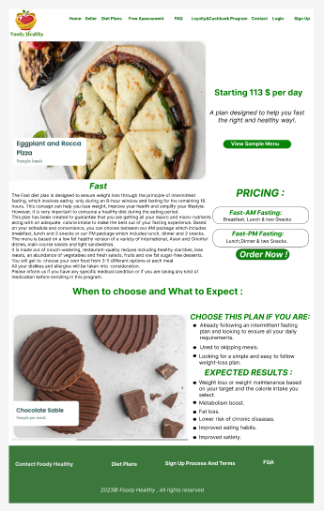

Slide 27
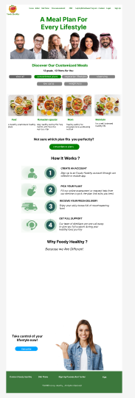

Slide 28
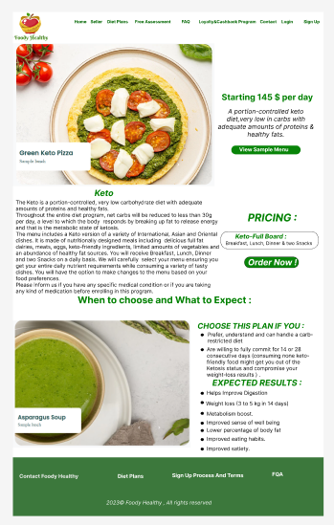

Slide 29
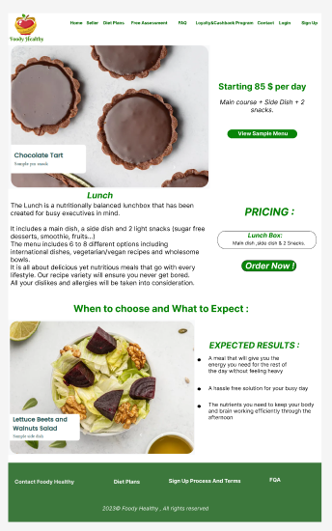

Slide 30
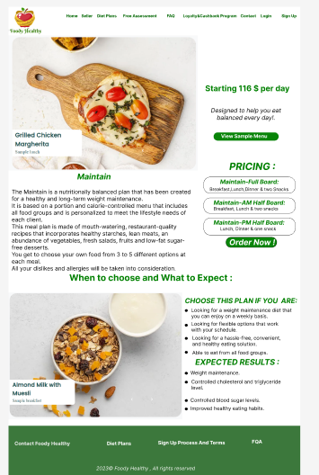

Slide 31
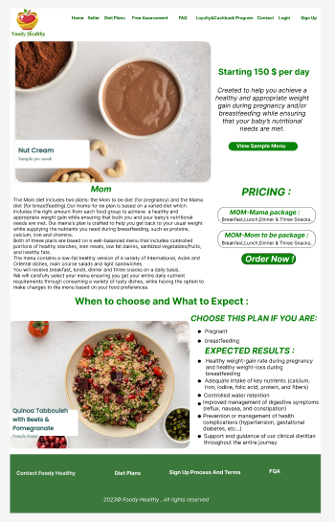

Slide 32
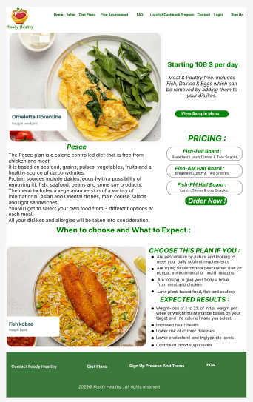

Slide 33
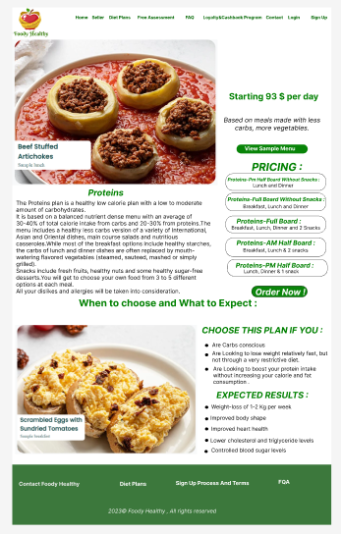

Slide 34
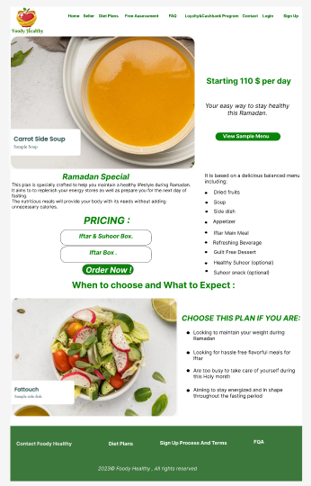

Slide 35
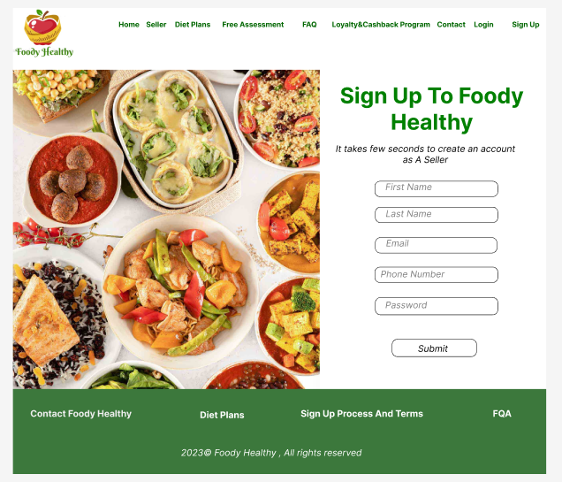

Slide 36
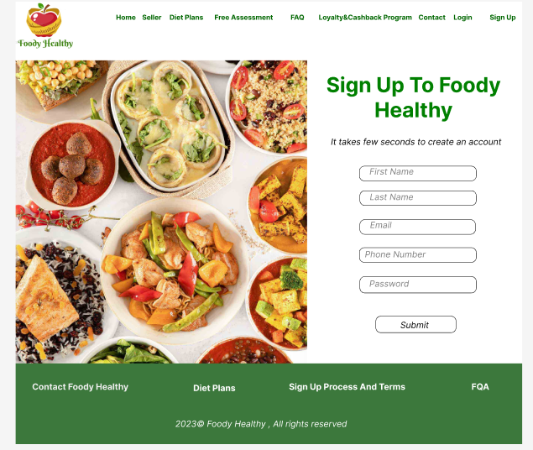

Slide 37
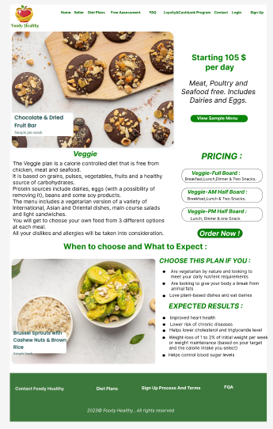

Slide 38
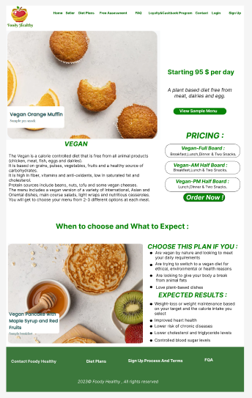

Slide 39
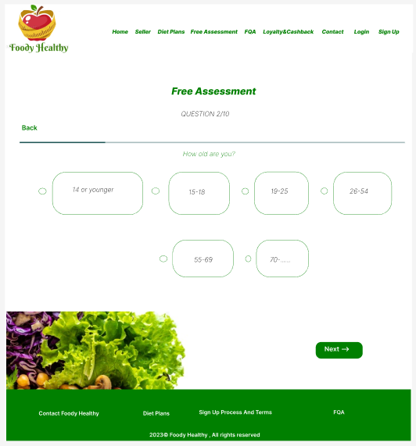

Slide 40
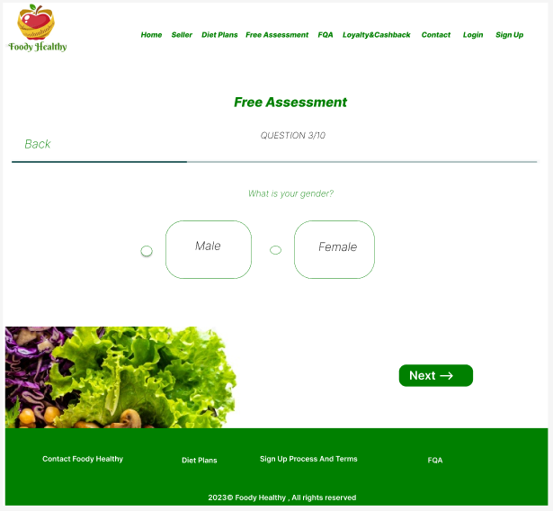

Slide 41
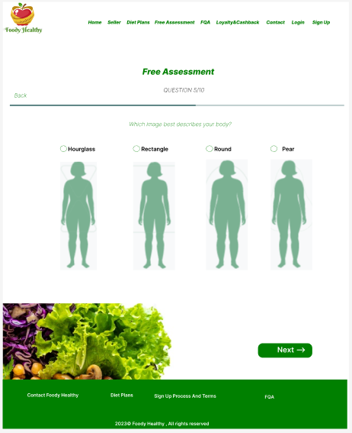

Slide 42
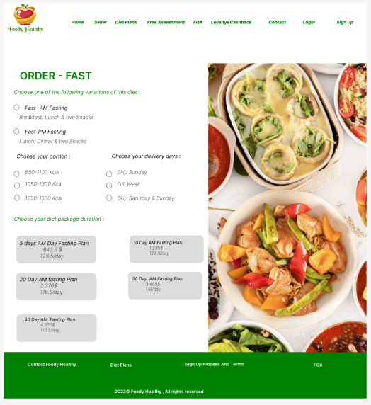

Slide 43
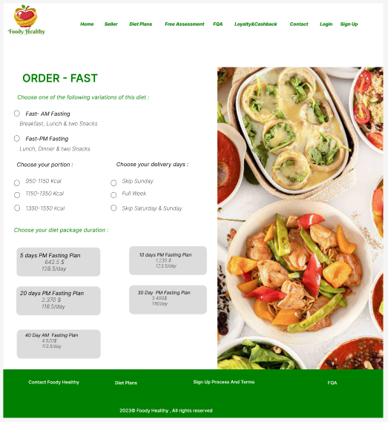

Slide 44
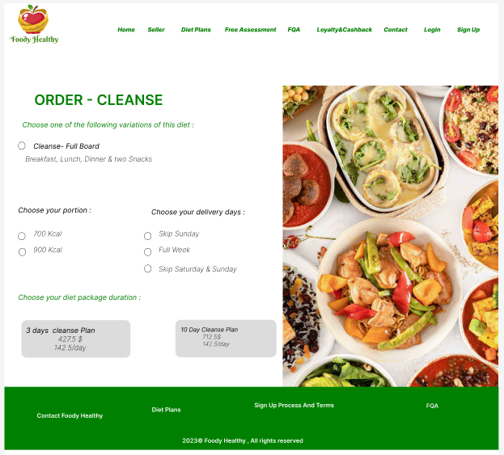

Slide 45


Slide 46
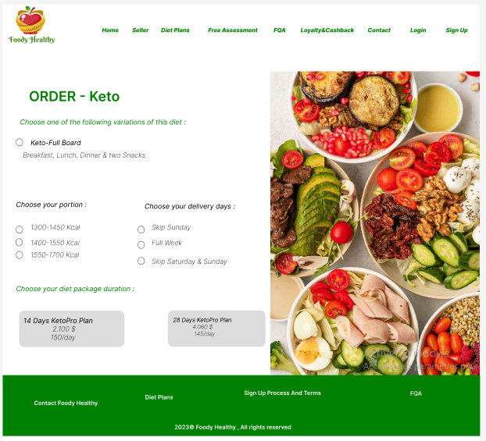

Slide 47
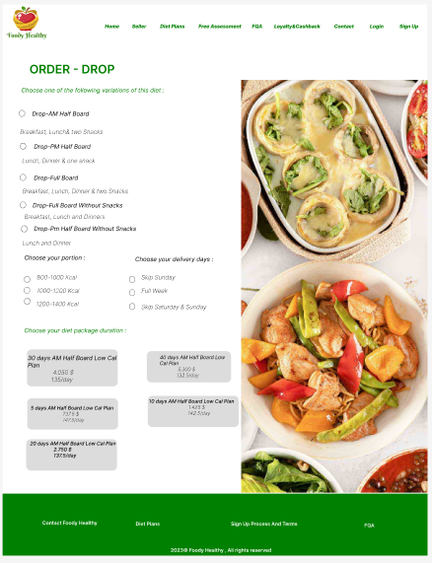

Slide 48
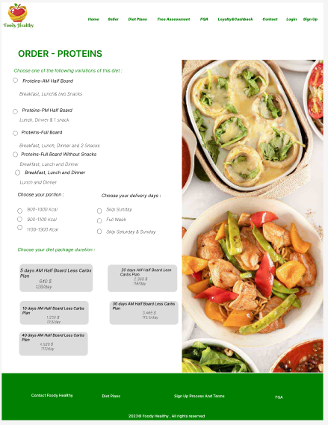

Slide 49
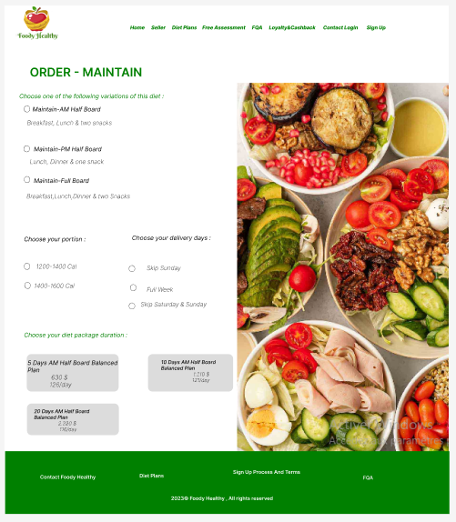

Slide 50
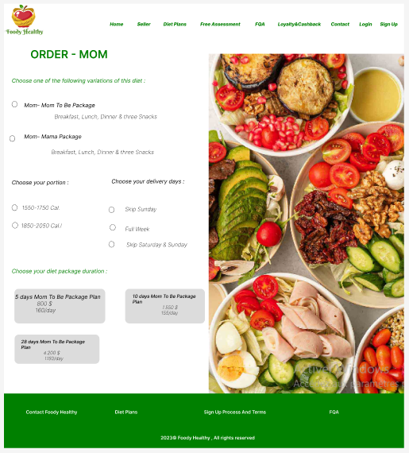

Slide 51
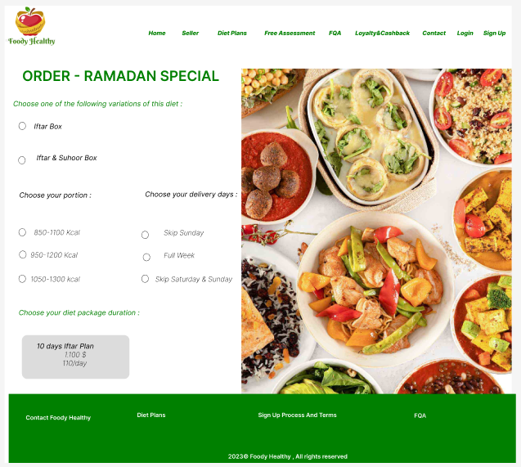

Slide 52
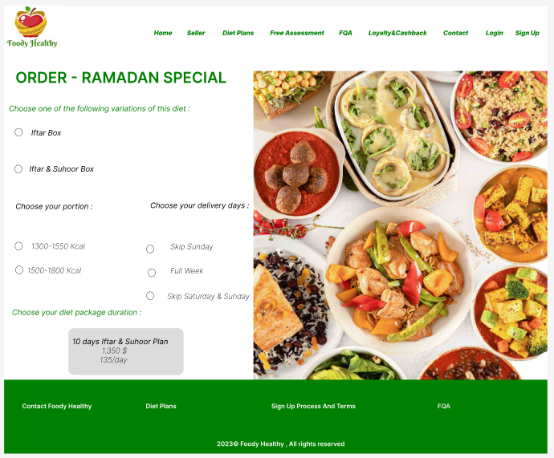

Slide 53
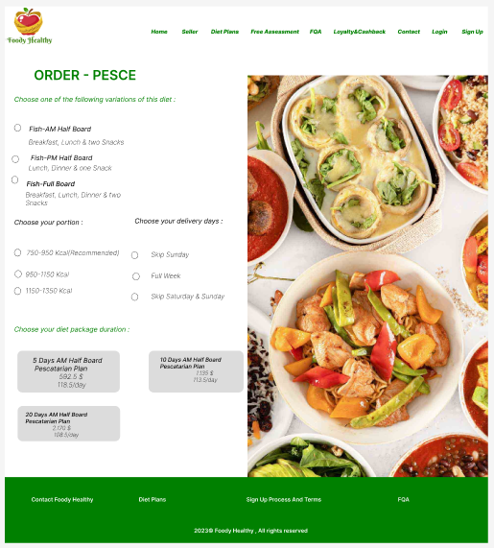

Slide 54
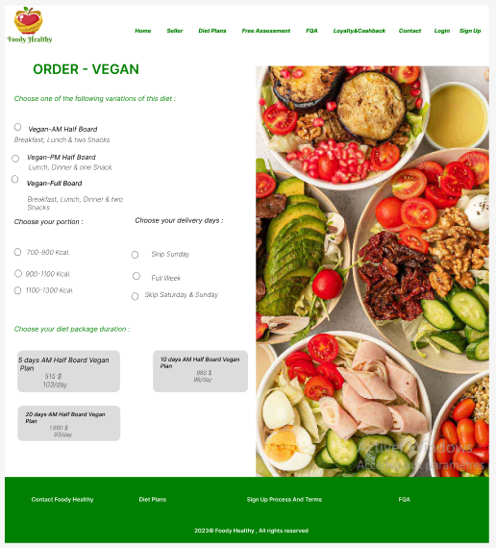

Slide 55
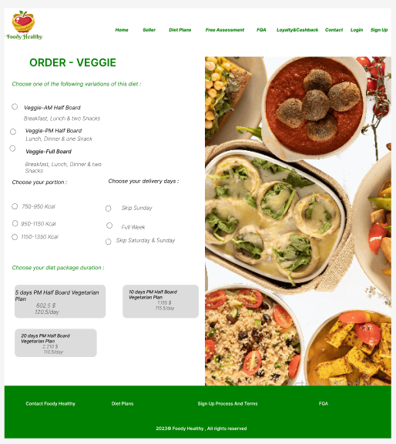

Slide 56
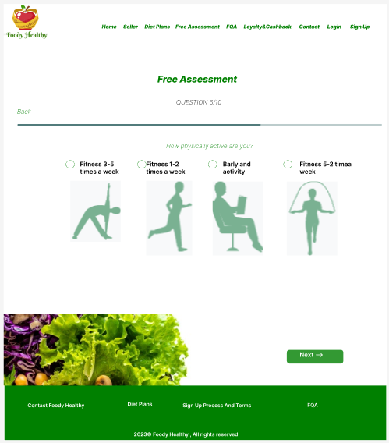

Slide 57


Slide 58


Slide 59


Slide 60


Slide 61


Slide 62


Slide 63


Slide 64


Slide 65


Slide 66


Slide 67


Slide 68


Slide 69

Graphic charter :
our logo is :

Slide 70
the size of titles will be 36 and their font will be bold and Century Gothic and their color will be green and its color code is #3CB043
the size of subtitles will be 24 and their font will be bold and Century Gothic and their color will be Juniper and its color code is #3A5311
the size of paragraphs will be 18 and their font will be Century Gothic and their color will be black and its color code is #000000

Slide 71
Screenshoots of our front-end development :

Slide 72


Slide 73


Slide 74


Slide 75



Slide 76





Slide 77




Slide 78



Slide 79



Slide 80



Slide 81




Slide 82




Slide 83


Slide 84




Slide 85


Slide 86




Slide 87


Slide 88




Slide 89


Slide 90



Slide 91


Slide 92


Slide 93


Slide 94


Slide 95


Slide 96


Slide 97



Slide 98


Slide 99




Slide 100



Slide 101


Slide 102


Slide 103


Slide 104



Slide 105





Slide 106





Slide 107


Slide 108
Thank You For Your Attention !

